Slide 1

Integrated Public Alert and Warning System
Get Alerts, Stay Alive
4 November 2010

Slide 2



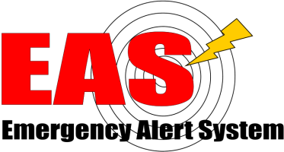

The Evolution of Emergency Broadcasting
1951 - 1963
1963 - 1997
1997 - 2006
2006
CONELRAD
EBS
EAS
IPAWS
Originally called the “Key Station System,” the CONtrol of ELectromagnetic RADiation (CONELRAD) was established in August 1951.
Participating stations tuned to 640 & 1240 kHz AM and initiated a special sequence and procedure designed to warn citizens.
EBS was initiated to address the nation through audible alerts. It did not allow for targeted messaging.
System upgraded in 1976 to provide for better and more accurate handling of alert receptions.
Originally designed to provide the President with an expeditious method of communicating with the American Public, it was expanded for use during peacetime at state and local levels.
EAS jointly coordinated by the FCC, FEMA and NWS.
Designed for President to speak to American people within 10 minutes.
EAS messages composed of 4 parts:
Digitally encoded header
Attention Signal
Audio Announcement
Digitally encoded end-of-message marker
IPAWS modernizes and integrates the nation’s alert and warning infrastructure.
Integrates new and existing public alert and warning systems and technologies
Provides authorities a broader range of message options and multiple communications pathways
Increases capability to alert and warn communities of all hazards impacting public safety.
Source: The Broadcast Archive
Maintained by: Barry Mishkind
The Eclectic Engineer
Notes:
2
Play “Duck and Cover” video

Slide 3
IPAWS Federal Guidance -
Executive Order 13407 states:
“It is the policy of the United States to have an effective, reliable, integrated, flexible, and comprehensive system to alert and warn the American people…”
“establish or adopt, as appropriate, common alerting and warning protocols, standards, terminology, and operating procedures for the public alert and warning system to enable interoperability and the secure delivery of coordinated messages to the American people through as many communication pathways as practicable…”
“administer the Emergency Alert System (EAS) as a critical component…”
“ensure that under all conditions the President of the United States can alert and warn the American people.”
1995 Presidential EAS Statement of Requirements states:
“The national level EAS must be: Fully integrated from the national to local level, yet capable of independent local (Priority Two) and state (Priority Three) operations”
The IPAWS Program Management Office was formed to implement Executive Order 13407

Slide 4
The IPAWS Program Vision, Mission, and Goals
Vision
Timely alert and warning to American citizens in the preservation of life and property.
Mission
Provide integrated services and capabilities to Federal, State, territorial, tribal, and local authorities that enable them to alert and warn their respective communities via multiple communications methods.
Goals
To attain the Vision and accomplish the Mission, FEMA has established three overarching strategic goals:
Goal 1 – Create and maintain an integrated interoperable environment for alert and warning
Goal 2 – Make Alert and Warning More Effective
Goal 3 – Strengthen the Resilience of IPAWS Infrastructure
Notes:
IPAWS is simple in concept yet complex in the required programmatic and technological approaches necessary to establish an integrated and interoperable system to allow our Nation’s leaders to alert and warn the American people.
IPAWS capability acknowledges the technological communications capabilities of today while establishing the ability to integrate technologies of the future.

Slide 5
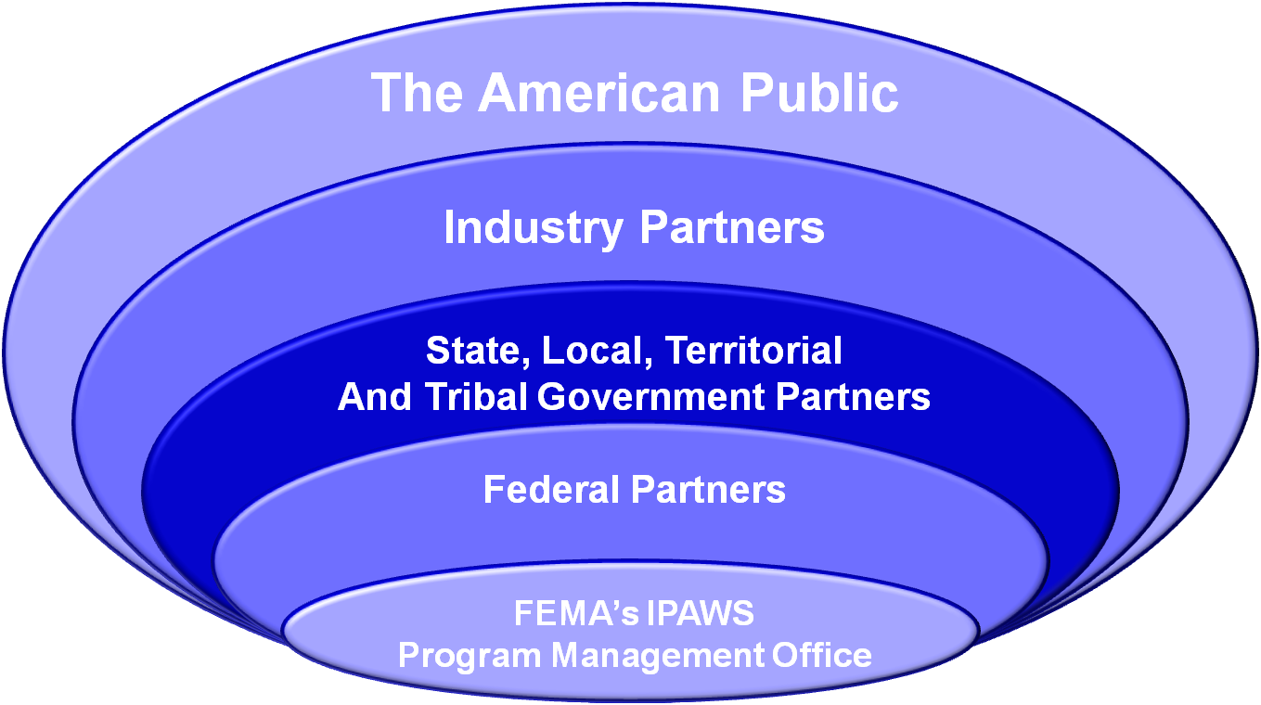


IPAWS Stakeholders
Successful private-public relationships are critical to IPAWS.
IPAWS is fulfilling the requirements in EO 13407 by reaching out to all stakeholders.

Slide 6


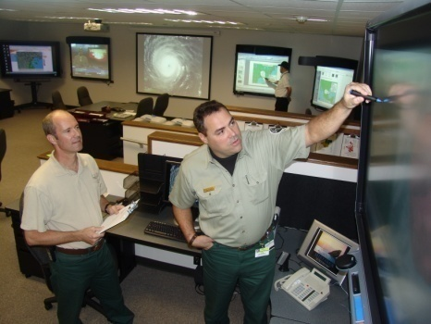




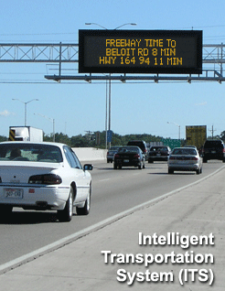
IPAWS Vision
Television
Timely Alert And Warning To American Citizens In The Preservation of Life And Property
Radio
Cell Phone
Alerting Authorities;
Federal, State, territorial, tribal, and local
Computer
Home Phone
IPAWS Alert Aggregators
Public Signage
Notes:
Picture (OV-1) of Vision –
– concept of single message delivered to multiple dissemination channels – integration, easier to use for alert authorities
This concept enhances alerting capability in two critical ways:
1 – increases the reliability that a citizen will receive an alert via at least one path
2 – increases likelihood that citizen seriously considers the alert because alert information available for verification/corroboration via multiple media paths

Slide 7






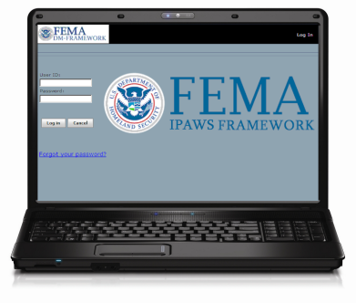

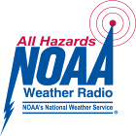
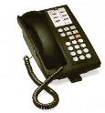

IPAWS Architecture
Standards Based Alert Message protocols, authenticated alert message senders, shared, trusted access & distribution networks, alerts delivered to more public interface devices
Alerting Authorities
IPAWS compliant CAP Alert Origination Tools
Alert Disseminators
American People
Federal
Emergency Alert System
Emergency
State
Aggregator/ Gateways
AM FM Satellite Radio;
Digital, Analog, Cable, and Satellite TV
Territorial
CAP messages
Tribal
Commercial Mobile Services
Cellular and Commercial Mobile Networks
cell phones, pagers
Local
IPAWS OPEN
CMAS
Internet Services
Web Browsers, widgets, web sites
CAP messages
IPAWS compliant CAP Alert Origination Tools
Open Platform for Emergency Networks
(message broker)
NOAA
HazCollect
NWS
FM RBDS
State / Local Unique Alerting Systems
ETN
Siren
Digital Signage
Notes:
Green = FEMA maintained interface Blue = NOAA System Grey = state and local, not FEMA funded interfaces and systems
OPEN (Open Platform for Emergency Networks) is a message broker for exchanging standards compliant emergency messages. OPEN v1.0 aka as DMIS, has been fielded in some localities to provide alert and warning message exchange with NOAA for non-weather hazard activation of the National Weather Radio network (HazCollect System).
Authorized alerting officials at all levels of government access the IPAWS service and send CAP messages through OPEN to public information distribution systems. Standard based CAP format emergency alert messages.
IPAWS builds and maintains the OPEN standards based interface and connection to public information dissemination channels:
- radio and TV via EAS
- cellular phone broadcast via CMAS
- NOAA Weather Radio via HazCollect
- Internet services via TBD
- Local Unique systems – such as Emergency Telephone Networks and local phone dialing system as well as other local alerting systems (e.g. siren, signboard)
IPAWS does not replace local alerting systems, but can be used by and integrated with local alerting systems

Slide 8
Fiscal Year
FY09
FY10
FY11
FY12
Q1
Q2
Q3
Q4
Q1
Q2
Q3
Q4
Q1
Q2
Q3
Q4
Q1
Q2
Project
Common Alerting Protocol (CAP)
CAP V1.2 Approval through OASIS
FEMA and Industry Preparation
Industry 180-day Transition
Implementation of CAP IPAWS Profile
(Facilitates integration of Federal/State/Local alert and warning systems)
IPAWS CAP Profile v1.2 Approved (10/12/09)
CAP to EAS Implementation
Guide Endorsed by FEMA (8/9/10)
OASIS CAP v1.2 Standard Approved
(7/1/10)
Submit CAP to EAS Translation Requirements
to OASIS
FEMA Announces IPAWS CAP Adoption
IPAWS Aggregator
(includes CMAS)
CMAS Interface Specifications
28-month Cellular Industry Development and Deployment Time
ATIS/TIA and FEMA approval
FEMA Announces IPAWS OPEN to Industry
FEMA Aggregator and Gateway
Online
Provides geo-targeted broadcast alerts to cellular devices
FEMA Announces Adoption of C-Interface
IPAWS 2.0
Online
(8/28/10)
Begin building Aggregator and Gateway
Primary Entry Point (PEP) Expansion
Design Phase
PEP Build Outs
Site
Surveys
and MOUs
Begin construction
10 Sites Completed
Accept Sites
32 Completed
Contract Award/ NTP
74 PEPS Operational
90% direct coverage of US Population
Inspections
100% Module Design
Complete
Fuel System Design/ FEMA Approval
Ribbon cutting
at first PEP
station in
Jacksonville, FL
20 Sites Completed
Initial Module Design
Notes:
CAP
three documents define CAP for IPAWS - (1) OASIS CAP Standard v1.2; (2) IPAWS Specification to the CAP Standard (CAP v1.2 IPAWS USA Profile v1.0); and (3) CAP to EAS Implementation Guide.
IPAWS has a NIMS STEP compliant conformance lab stood up at EKU.
IPAWS plans to adopt the CAP standard as a common alert messaging protocol in Sept 2010 – this begins 180 day compliance window for all FCC licensed broadcasters to be able to receive an IPAWS CAP message.
OASIS = Organization for the Advancement of Structured Information Standards
Aggregator
IPAWS and the FCC formally announced the government interface specifications (C-Interface) for the IPAWS – CMAS Gateway which will deliver cellular text messages to cellular providers who opt-in to the IPAWS CMAS system. Announcement began 28-month compliance clock for cellular providers to be ready to receive alert and warning messages for broadcast to cellular devices. FEMA will have the IPAWS CMAS Gateway operational in Feb 2011.
PEP Expansion
FEMA IPAWS is doubling the number of Primary Entry Point (PEP) radio stations to provide direct coverage of 90% of the US population. PEP Expansion completes in summer of 2011. The FEMA PEP stations are the broadcast origination point for Presidential and National Emergency Information – all other FCC licensed broadcast stations (cable and satellite stations included) must have an FCC approved method of receiving the Presidential message from a FEMA PEP station (typically defined in State EAS plans). In addition to providing more direct coverage of citizens, the expanded number of FEMA PEP stations makes it easier for all other broadcast stations to monitor a PEP (i.e. shortens audio relay distances)

Slide 9
IPAWS Project Areas
Emergency Alert System – modernization and expansion of EAS - implementation of next generation digital format for distribution of alerts; the Common Alerting Protocol (CAP); doubling of FEMA connected Primary Entry Point (PEP) stations to provide direct EAN broadcast coverage to 90% + of the United States population
Commercial Mobile Alert System (CMAS) – system enabling alert authorities access to cellular networks for broadcast of alert messages in text format (capability is alert message broadcast to a location, not a subscription SMS based service)
IPAWS Alert Aggregator (OPEN) – a CAP message broker and dissemination gateway providing authenticated alert authorities at all levels (federal state territorial, tribal, local) access to public communications networks for dissemination of alert and warning information
Integration of capabilities and access with NOAA capabilities
Training Development and Outreach
Study and Development of better alerting capabilities – especially for Americans with functional and special access needs and non-English speakers
IPAWS is enhancing and modernizing the National EAS system while developing additional capabilities that will be available for use by all levels of alert authority (digital alert distribution to broadcasters, cellular broadcast alerts, integration with NOAA networks)
IPAWS does not replace local alerting systems. Through integration, IPAWS can provide additional capabilities to local alerting authorities.

Slide 10
IPAWS Milestones & Activities
IPAWS Technical Specification to Common Alerting Protocol v1.2 (Completed – Nov 2009)
Commercial Mobile Alerting System Interface Specification (Completed – Dec 2009)
Conducted live code exercise of national EAS (EAN) in Alaska (Completed – Jan 2010)
First Expansion Primary Entry Point station brought online (31 August 2010)
DM-OPEN v 2.0 brought online in FEMA data center (29 August 2010)
  DMIS / OPEN v1.0 remains online in DHS data center for transition period
Accepted the ECIG CAP to EAS Implementation Guide (August 2010)
  Document available at: http://www.eas-cap.org/documents.htm
Formally adopted Common Alerting Protocol (CAP v1.2) (September 2010)
Moving Forward:
Conformance testing of vendor products to IPAWS CAP Profile
  Lab web site/vendor application at: https://www.nimssc.org/ipawsconform/default.asp
IPAWS CMAS Gateway available for carrier testing (Feb 2011)
Inventory of State and Local EOC Alert and Warning Capabilities
Nationwide exercise of the national Emergency Alert System (2011)

Slide 11
Comments and Questions
IPAWS Website - http://www.fema.gov/emergency/ipaws
Damon.Penn@dhs.gov
Office (202) 646-4145
Assistant Administrator, National Continuity Programs, DHS FEMA
Antwane.Johnson@dhs.gov
Office: (202) 646-4383
Director, Integrated Public Alert and Warning System Division
Wade.Witmer@dhs.gov
Office: (202) 646-2523
Deputy Director, Integrated Public Alert and Warning System Division

